Slide 1
CROP RECOMMENDATION SYSTEM USING MACHINE LEARNING USING K-NEAREST NEIGHBORS ALGORITHM)

Slide 2
ABSTRACT
Agriculture is the primary source of livelihood for 58% of the global population, yet many farmers rely on intuition rather than data to select crops, often leading to inefficient yields and financial losses. To address this challenge, we propose a machine learning-based solution that recommends the most suitable crops based on environmental conditions and soil fertility. Our approach utilizes various machine learning algorithms, including Random Forest, Support Vector Machine, K-Nearest Neighbours (KNN), Naive Bayes, and Decision Tree models, to predict the optimal crops for given conditions. The system takes into account factors like temperature, rainfall, humidity, soil pH, and nutrient levels, which are correlated with crop yields.
We have developed a user-friendly interface using Python, where farmers can input their location and environmental data such as temperature and humidity. The system then suggests the best crops suited to their specific conditions. The models are trained on historical datasets sourced from platforms like Kaggle and the Food and Agriculture Organization of India, ensuring accurate and localized recommendations.

Slide 3
1.LITERATURE SURVEY-Enhancing Agricultural Productivity: A Machine Learning Approach to Crop Recommendations
Algorithm/Architecture and Models | Results & Key Findings
Logistic Regression, Support Vector Machine, K-Nearest Neighbors, Decision Tree, Random Forest, Bagging, AdaBoost, Gradient Boosting, Extra Trees. | Random Forest achieved the highest accuracy of 99.31%, showcasing superior performance compared to other models.
Data preprocessing included normalization, cleansing, and cross-validation. | The system provided robust crop recommendations tailored to specific soil and climate conditions.

Slide 4
MERITS AND DEMERITS
Merits:
High accuracy (Random Forest achieved 99.31%) in crop recommendations.
Incorporates multiple ML models (e.g., LR, SVM, RF, etc.) for diverse results.
Robust system with a focus on feature selection and data preprocessing.
Effective in identifying relationships between soil nutrients and climatic factors.
Demerits:
Computationally intensive due to the training of nine ML models simultaneously.
Potential overfitting with complex ensemble models.

Slide 5
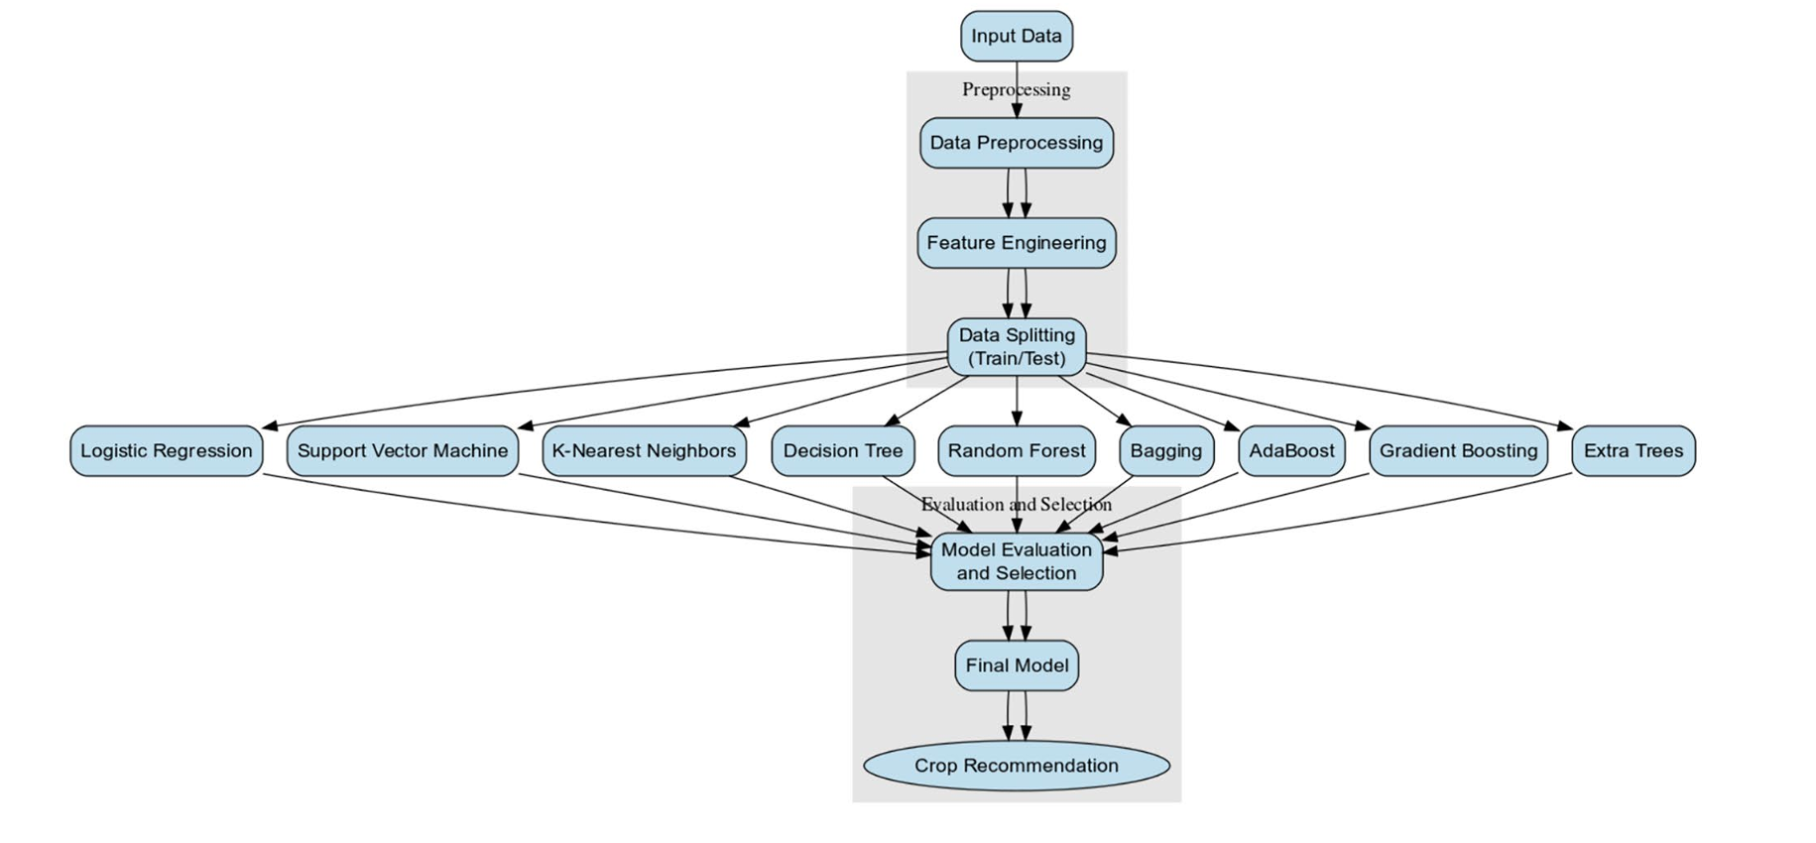
DIAGRAM

Slide 6
2.LITERATURE SURVEY-Crop Recommendation Using Machine Learning Techniques
Algorithm/Architecture and Models | Results & Key Findings
K-Nearest Neighbors (KNN), Decision Tree (DT), Random Forest (RF), Naive Bayes (NB), Gradient Boosting. | RF demonstrated superior accuracy and efficiency in crop prediction tasks.
Focus on feature engineering for soil parameters (pH, NPK levels, humidity). | Optimized crop selection increased productivity and sustainability.

Slide 7
MERITS AND DEMERITS
Merits:
Simple and interpretable ML algorithms like KNN, Decision Tree, and Random Forest used.
System aids farmers in making educated decisions based on soil and weather parameters.
Scalable for different regions using diverse datasets.
Demerits:
Limited to basic ML techniques; may not handle complex dependencies well.
Accuracy can vary significantly depending on the dataset quality.

Slide 8
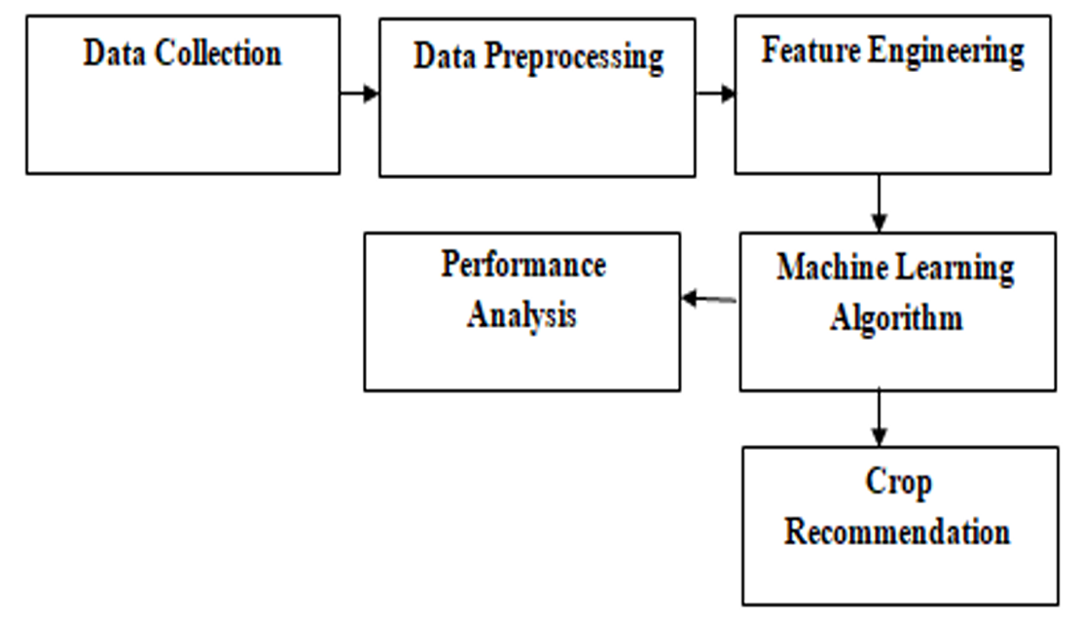
DIAGRAM

Slide 9
3.LITERATURE SURVEY-Crop Recommendation System using IoT and ML​
Algorithm/Architecture and Models | Results & Key Findings
Random Forest (RF), Convolutional Neural Network (CNN). | RF achieved high accuracy for crop suggestions based on soil data.
IoT sensors for real-time monitoring (soil pH, NPK, temperature). | Enhanced disease detection and reduced soil degradation risks.

Slide 10
MERITS AND DEMERITS
Merits:
Integrates IoT sensors for real-time monitoring of soil and environmental parameters.
Employs CNN for disease detection, enhancing crop health management.
Reduces soil degradation risks by continuous monitoring.
Demerits:
High setup cost due to IoT devices.
Dependency on stable network connectivity for real-time data analysis.

Slide 11
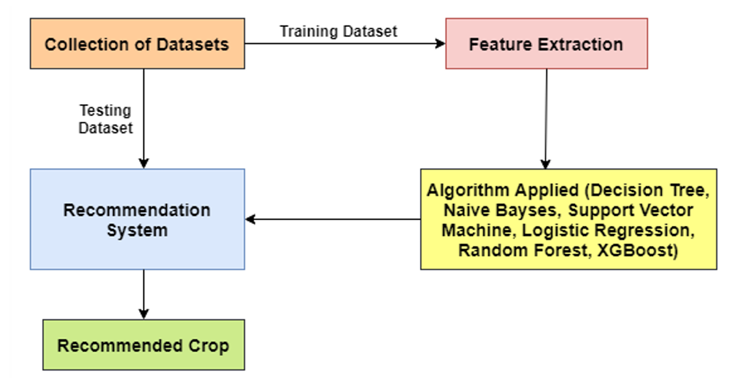
DIAGRAM

Slide 12
4.LITERATURE SURVEY-Intelligent Crop Recommendation System
Algorithm/Architecture and Models | Results & Key Findings
Ridge Regression, Ensemble Models with Random Tree, KNN, Naive Bayes. | Improved accuracy and adaptability to regional variations using ensemble techniques.
Data from various government and Kaggle datasets. | Recommendations maximized crop yield and provided optimal fertilizer use suggestions.

Slide 13
MERITS AND DEMERITS
Merits:
Suggests optimal crops based on economic and environmental conditions.
Incorporates a recommender system for fertilizer usage timing.
Provides real-time crop yield predictions, enhancing decision-making.
Demerits:
Relies heavily on historical data accuracy, which might not always be reliable.
Limited adaptability to hyper-localized conditions.

Slide 14
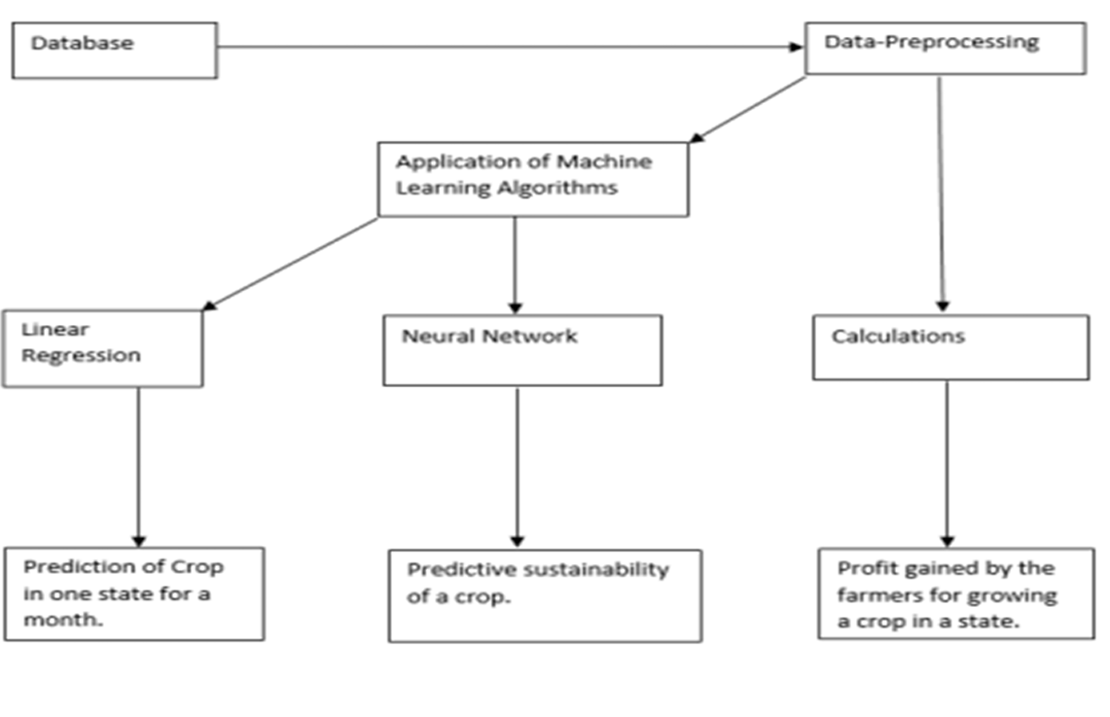
DIAGRAM

Slide 15
5.LITERATURE SURVEY-Crop Recommendation Using Ensemble Models
Algorithm/Architecture and Models | Results & Key Findings
Decision Tree, Naive Bayes, K-Nearest Neighbors, Random Forest, Logistic Regression. | RF consistently delivered the best accuracy for soil and crop mapping across regions.
Emphasized regional customization through location and climate analysis. | Effective in reducing crop failure and boosting farmer profits.

Slide 16
MERITS AND DEMERITS
Demerits:
Ensemble methods may require more computational resources.
Accuracy depends on the quality and variety of training datasets.
Merits:
Uses ensemble models like Random Forest for high predictive accuracy.
Incorporates ranking techniques for improved decision-making.
Efficient in handling diverse land conditions.

Slide 17
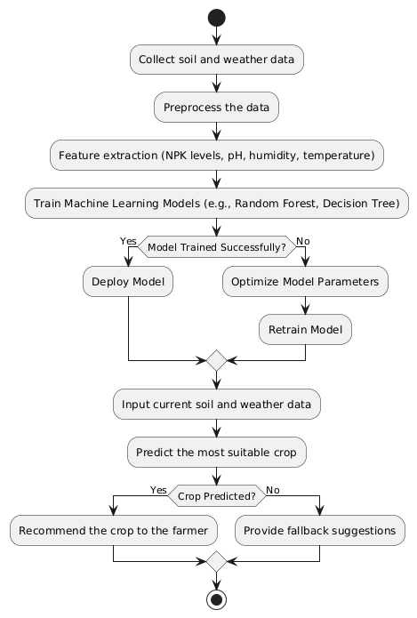
DIAGRAM

Slide 18
6.LITERATURE SURVEY-Deep Learning-Based Crop Recommendation System
Algorithm/Architecture and Models | Results & Key Findings
Random Forest, Convolutional Neural Network (CNN), IoT Integration. | Integrated IoT with ML ensured real-time monitoring and accurate crop suggestions.
Explainable AI (XAI) for transparency in decision-making. | Dynamic adaptation to environmental changes improved trust and usability for farmers.

Slide 19
MERITS AND DEMERITS
Merits:
Utilizes Explainable AI for transparency in recommendations.
Dynamic adaptation using IoT sensors for real-time data integration.
User-friendly interface tailored for farmer engagement.
Demerits:
Limited accessibility in regions with low technological penetration.
Real-time data processing can be resource-intensive.

Slide 20
Proposed System
Our proposed system integrates machine learning to analyze critical agricultural parameters and recommend optimal crops. Additionally, it predicts crop yield based on various environmental factors. Key features of the system include:
Algorithms: K-Nearest Neighbors (KNN) for crop recommendation, Random Forest for yield prediction.
Input Parameters for Crop Recommendation: Nitrogen, Phosphorus, Potassium, temperature, humidity, pH, and rainfall.
Input Parameters for Yield Prediction: Area, crop type, year, average rainfall, pesticide usage, and average temperature.
Dataset Sources: Kaggle, FAO, and historical agricultural data.
Outputs:1.Recommended crop for given soil and weather conditions.
2.Estimated crop yield based on historical and environmental data.
Interface: Web-based application using Flask for easy farmer and investor accessibility.
Functionality:1. Farmers input soil and climate data to receive crop recommendations.
2. Investors input agricultural parameters to predict expected crop yield.

Slide 21
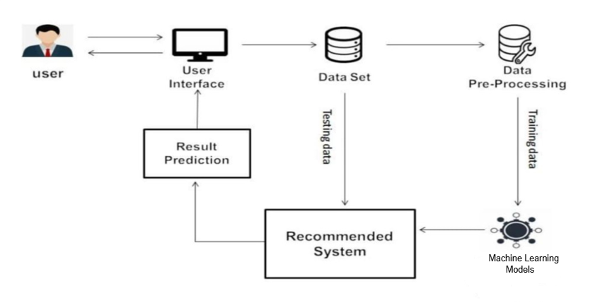
DIAGRAM

Slide 22
Implementation
1. Data Collection and Preprocessing
Datasets: Crop Recommendation dataset from Kaggle and FAO.
Data Cleaning: Handling missing values, normalizing features.
Feature Engineering: Encoding categorical crop names, standardizing numerical values.
Train-Test Split: 80% training, 20% testing for model evaluation.
2. Model Development
KNN Model: Determines the nearest neighbors based on feature similarity for crop recommendation.
Random Forest Model: Predicts expected crop yield based on historical data and environmental conditions.
Distance Metric: Euclidean distance for classification (KNN).
Hyperparameter Tuning: Optimizing K value for best performance.
Model Evaluation: Accuracy, Precision, Recall, F1-score, Confusion Matrix.

Slide 23
3. Web Application Development
Frontend: HTML, CSS, JavaScript.
Backend: Flask framework (Python).
Functionality:
Farmers input soil and climate data, system returns crop recommendation.
Investors input agricultural parameters, system predicts crop yield.

Slide 24
Results
The system was tested with real-world agricultural data, achieving high accuracy levels:
Model | Accuracy (%)
KNN | 97.04
Decision Tree | 98.63
Random Forest | 99.31
Naïve Bayes | 99.54
XGBoost | 98.6
Logistic Regression | 94.54
SVM | 96.13
AdaBoost | 14.54
Gradient Boosting | 98.18

Slide 25
The KNN algorithm performed well with a 97.04% accuracy, proving effective for real-time crop recommendation, while the Random Forest model provided accurate yield predictions.
Crop Recommendation Analysis: The system successfully categorized crops based on soil and climatic conditions, with high precision and recall scores. The confusion matrix indicated minimal misclassification, ensuring reliable recommendations.
Crop Yield Prediction Analysis: The Random Forest model demonstrated strong predictive performance with minimal error margins. The regression model accurately forecasted crop yields based on factors such as temperature, rainfall, and pesticide use, providing valuable insights for investors and farmers.
Web Application Performance: The Flask-based interface efficiently processed user inputs and returned predictions in real-time. The system’s response time was optimized, ensuring a smooth user experience.

Slide 26
Conclusion
This research presents a machine learning-based crop recommendation and yield prediction system using KNN and Random Forest algorithms. The system ensures precision agriculture, reducing financial risks for farmers and aiding investors in making informed decisions. The system effectively processes input parameters such as soil nutrients and environmental conditions to generate highly accurate recommendations.
The web application provides a user-friendly experience, delivering real-time results and predictions within seconds. The yield prediction model allows investors to assess potential crop productivity, enhancing agricultural decision-making. By integrating real-time environmental data and optimizing models, the system can further enhance its accuracy and usability. Future improvements include IoT integration for real-time soil data collection, mobile app development for broader accessibility, and the incorporation of advanced deep learning techniques to refine crop and yield predictions.

Slide 27
THANK YOU

